Slide 1
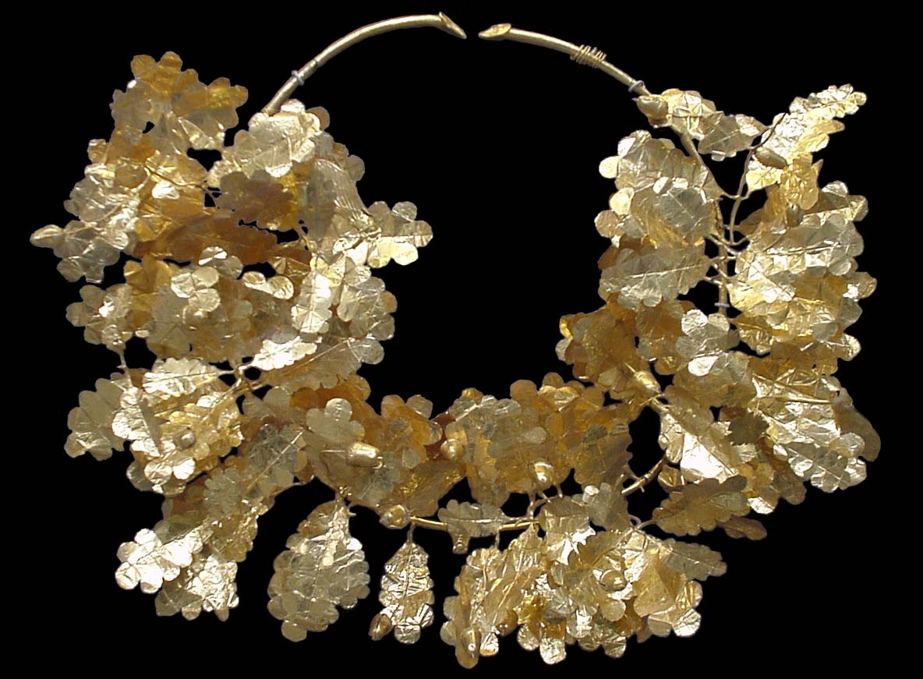
Hydrostatics: Buoyancy and Density

