Slide 1
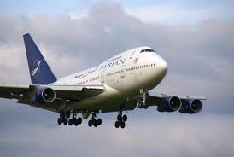
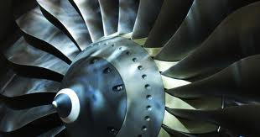
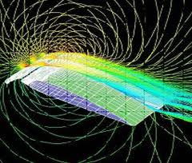
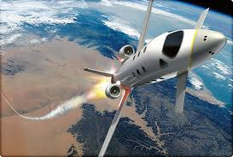
Aerospace Engineering
Notes:
http://t1.gstatic.com/images?q=tbn:ANd9GcTKNjB7x-yD5WxE19I8uTXJ9PM2ZroPaDUTPCQ2KUX4pLRN_1SPdw
http://www.ryerson.ca/aerospace/images/funky_image.jpg
http://t3.gstatic.com/images?q=tbn:ANd9GcR6Ff3jwITcIVjjfPGe2YrnZFceBH9LadWvBP6Rp6-Dsz7S1nDU
http://t3.gstatic.com/images?q=tbn:ANd9GcSmNpV1fYfZ3wFvJ5KrQHlAt8QYl77xE1pCxtkBOQpBdMZAIT_EOA

