Slide 1
How Many People Does it Take to…: A Parallel Approach to the Party Problem

Slide 2
The Party Problem
How many people need to attend a party to guarantee that there is group of m people who all know each other or a group of n people who are all complete strangers?
R(m, n)
We focus on R(m, m)

Slide 3
What’s R(3, 3)?
Must be at least 3!
If we use red ropes and blue ropes to represent know/don’t know…
Volunteers! 4 groups of 3, use these ropes (hand them out)
1
2
1
2
1
2
1
2
3
3
3
3
Group 1 Group 2 Group 3 Group 4
Notes:
Hand out ropes as shown in slide.
Groups 3 & 4 do not have a monochromatic K₃, so R(3,3) > 3

Slide 4
3 Not Right? Try 4!
How many hands do you have? How much rope?
How tangled can I get you?
Fun to visualize
Go 2D using graphs
  Vertices
  Edges
1
1
2
4
3
3
2
4
Notes:
Hand out ropes as shown in slide
The groups with 4 red ropes does not have a monochromatic K₃, so R(3,3) > 4

Slide 5
Terminology
Complete Graph K_{n}
Subgraph
Edges in K_{n} = (n*(n-1))/2 Why?

Slide 6
Showing R(3, 3) = n
Must show every possible graph with n vertices contains red or blue K₃
How many graphs do we need to check to show R(3,3) = n?
n vertices → (n*(n-1))/2 edges, each w/2 choices (red or blue) so 2^{(n*(n-1))/2} graphs
If n = 3...

Slide 7
If R(3,3) = 5...
Must check all graphs with 5 vertices...
… unless we find one without monochromatic K₃
Can skip isomorphisms, but for this class, we won’t worry about that.

Slide 8
Can you find a counter example or is R(3,3) = 5?

Slide 9
R(3,3) ≠ 5
1
2
3
4
5

Slide 10
Known Bounds on R(m, n) [1]
n m | 3 | 4 | 5 | 6 | 7 | 8 | 9 | 10
3 | 6 | 9 | 14 | 18 | 23 | 28 | 36 | 40 43
4 |  | 18 | 25 | 35 41 | 49 61 | 56 84 | 73 115 | 92 149
5 |  |  | 43 49 | 58 87 | 80 143 | 101 216 | 125 316 | 143 442
6 |  |  |  | 102 165 | 113 298 | 130 495 | 169 780 | 179 1171
7 |  |  |  |  | 205 540 | 216 1031 | 237 1713 | 289 2826
8 |  |  |  |  |  | 282 1870 | 317 3583 | 6090
9 |  |  |  |  |  |  | 565 6588 | 580 12677
10 |  |  |  |  |  |  |  | 798 23556

Slide 11
Our Problem: R(5,5) = ?
43 ≤ R(5,5) ≤ 49
We’ll try to show R(5, 5) ≥ 46.
Test every graph on 45 vertices.
  If any graph has no red K₅ AND no blue K₅, then stop: R(5, 5) > 45
  Otherwise R(5, 5) ≤ 45
How do we test a graph?

Slide 12
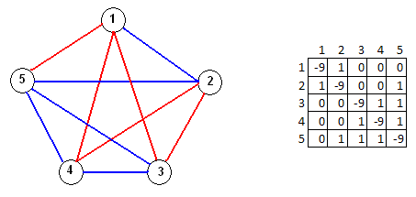
Testing a Graph
Represent a graph with adjacency matrix.
Systematically generate sets of 5 vertices until we find a set {a, b, c, d, e} such that matrix[a][b] = matrix[a][c] = matrix[a][d]… = matrix[d][e] or we run out of sets.
If we find such a set, the graph has a red or blue K5. Stop.
Otherwise, the graph has neither a red nor blue K5.

Slide 13
Testing a Graph
Represent a graph with adjacency matrix
Do we need the diagonal?
Do we need the information below the diagonal?

Slide 14
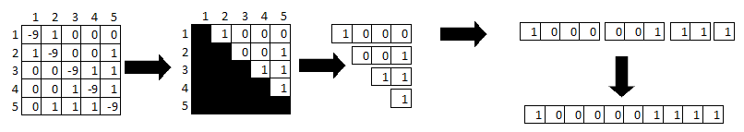
What’s Necessary?
Do we need the information on the diagonal?
Do we need the information below the diagonal?
Turn it into a one-dimensional array for ease of working with CUDA as shown:

Slide 15
Working with the Flattened Matrix
Viewing each slot as a digit in a binary number, easy to cycle through all graphs
  Start with all zeros
  Add one (and do carries as necessary) to move to next graph
  At all ones, done
  Easy to divide search space for parallel

Slide 16
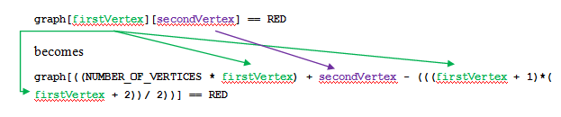
Working with the Flattened Matrix
How do we convert 2D array subscripts to 1D array subscripts?

Slide 17
References
[1] S. P. Radziszowski. (Originally published July 3, 1994. Last updated August 4, 2009). Small Ramsey Numbers. The Electronic Journal of Combinatorics. DS1.10. [Online]. Available: http://www.combinatorics.org/Surveys/ds1/sur.pdf. Accessed 5/11/10.

