Slide 1
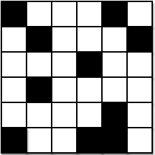
Parallelization: Conway’s Game of Life

Slide 2
Cellular automata: Important for science
Biology
  Mapping brain tumor growth
Ecology
  Interactions of species competing for resources
Cognitive science, hydrodynamics, dermatology, chemistry, environmental science, agriculture, operational research, and many others

Slide 3
Cellular automaton
Has a grid of cells
Performs functions automatically
Exhibits chaotic behavior – initial set of conditions produces random result after certain number of time steps

Slide 4
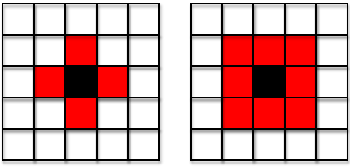
Neighborhoods
Von Neumann Moore

Slide 5
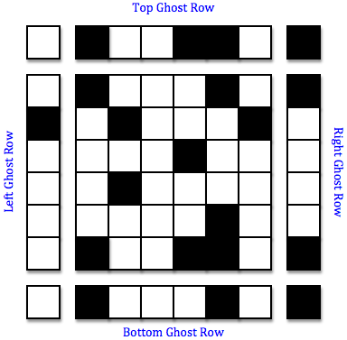
Toroidal grid

Slide 6
Conway’s Game of Life
2 cell states: ALIVE and DEAD
4 rules:
  If a cell has fewer than 2 ALIVE neighbors, it will be DEAD in the next time step
  If an ALIVE cell has 2 or 3 ALIVE neighbors, it will be ALIVE in the next time step
  If a cell has more than 3 ALIVE neighbors, it will be DEAD in the next time step
  If a DEAD cell has 3 ALIVE neighbors, it will be ALIVE in the next time step

Slide 7
How do we simulate?
Small board: with pencil and paper
Beyond a small board: single computer
Even bigger: parallel processing
Bigger and bigger: cluster computer

Slide 8
Parallelism
Concurrency (doing things at the same time)
Multiple flows of execution (virtual entities that perform computations) working on the same problem
Distributed Memory
Shared Memory
Hybrid

Slide 9
Flows of execution
Processes
  Distributed memory
  Must communicate (message passing)
Threads
  Shared memory
Processes with threads
  Hybrid

Slide 10
Parallel hardware
Multiple cores on a single compute node
  Shared memory
Multiple compute nodes sharing a network
  Distributed memory
Multiple compute nodes with multiple cores sharing a network
  Hybrid

Slide 11
What are some standards?
Message Passing Interface (MPI) – distributed memory/message passing
OpenMP – shared memory
MPI/OpenMP - hybrid

Slide 12
How to approach the parallel algorithm
State clearly the goal of the algorithm
Use the goal to determine the algorithm’s data structures
Identify the data that will be contained within the data structures and parallelized
Determine load balancing
Determine the parallel tasks that are performed on the data – draw pictures and write descriptions
Determine message passing
Create a written representation of values needed for the parallel tasks
Develop pseudo-code for the algorithm

Slide 13
Considerations
Assume hybrid parallelism
  Distributed memory, shared memory, or serial can be refined from hybrid
    Hybrid on 1 thread per process is just distributed memory
    Hybrid on 1 process is just shared memory
    Hybrid on 1 thread and 1 process is just serial
The entire code is executed by each process
Threads only execute code for which they are spawned

Slide 14
What is the goal of the algorithm?
A grid of cells is updated at each time step for some number of time steps based on the rules of Conway’s Game of Life.

Slide 15
What are the algorithm’s data structures?
A grid of cells is updated at each time step for some number of time steps based on the rules of Conway’s Game of Life.

Slide 16
What are the algorithm’s data structures?

Slide 17
What data is parallelized?
Each process receives a certain number of rows
Each thread receives a certain number of columns

Slide 18
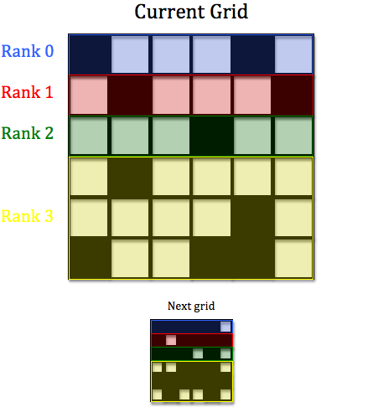
How is the load balanced?

Slide 19
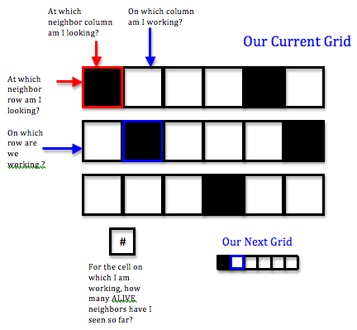
What are the parallel tasks?

Slide 20
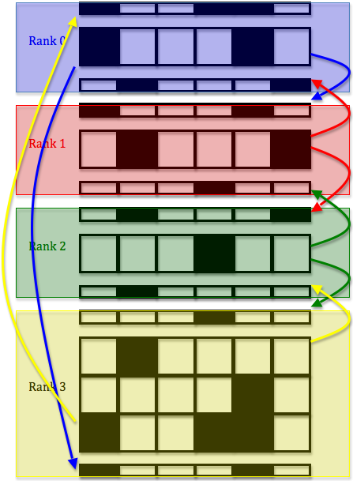
What message passing occurs?

Slide 21
What values are needed for the parallel tasks?

Slide 22
MPI functions

Slide 23
OpenMP construct

